Slide 1
mouse CD16 not strong as human CD16 stimulation

Slide 2
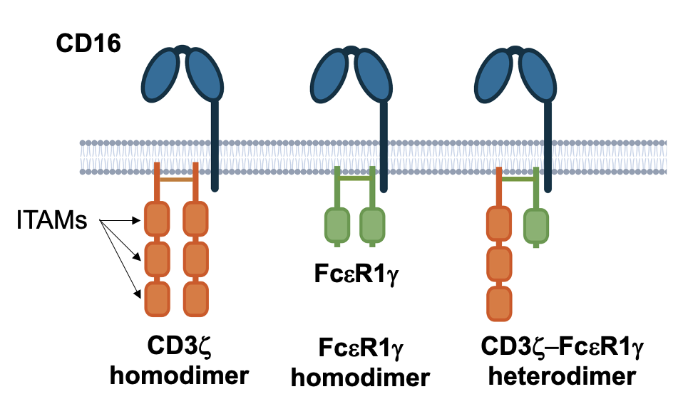
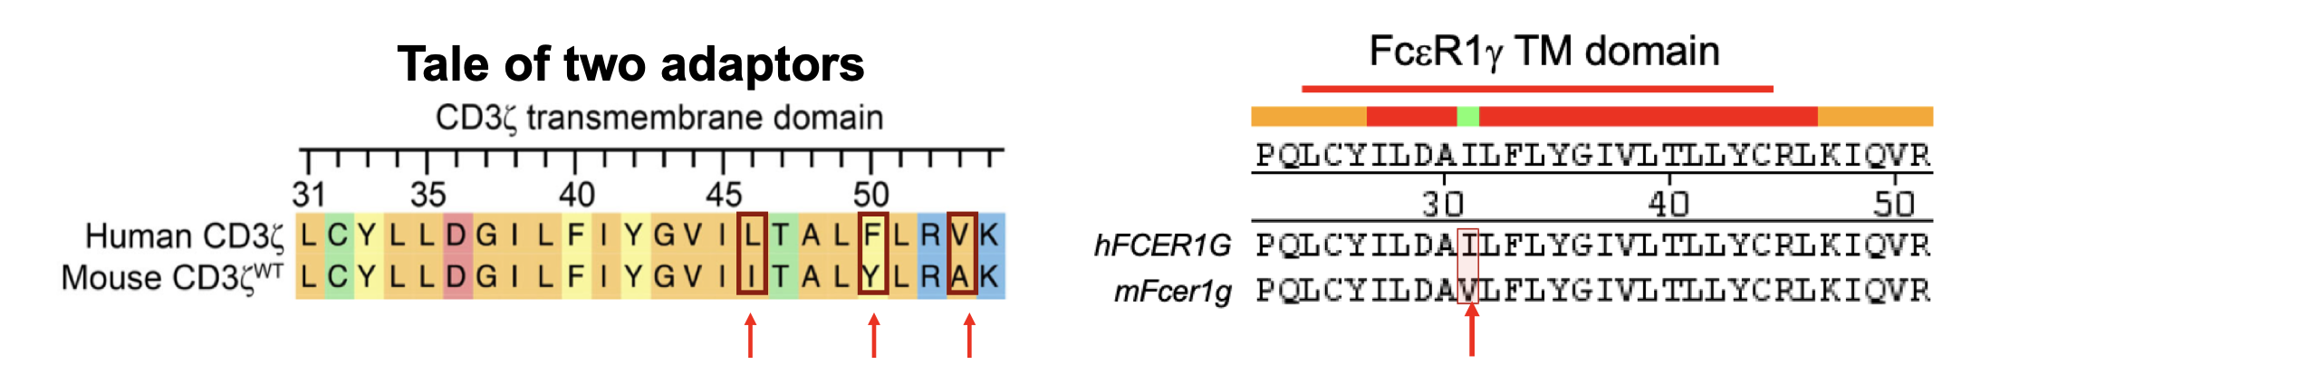
Difference in the ITAM numbers of adaptors

Slide 3
Measuring Ca++ flux in BWZ cells
Mouse/ human CD16, CD3z, FceR1g transduced
CD16 Stimulation

Slide 4
Measuring Ca++ flux in BWZ cells
Human CD16
Mouse CD16

Slide 5
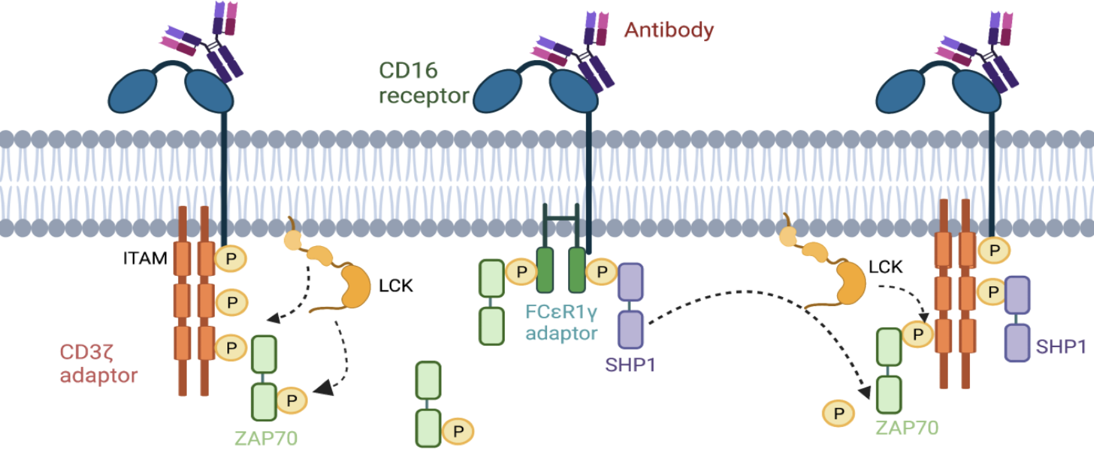

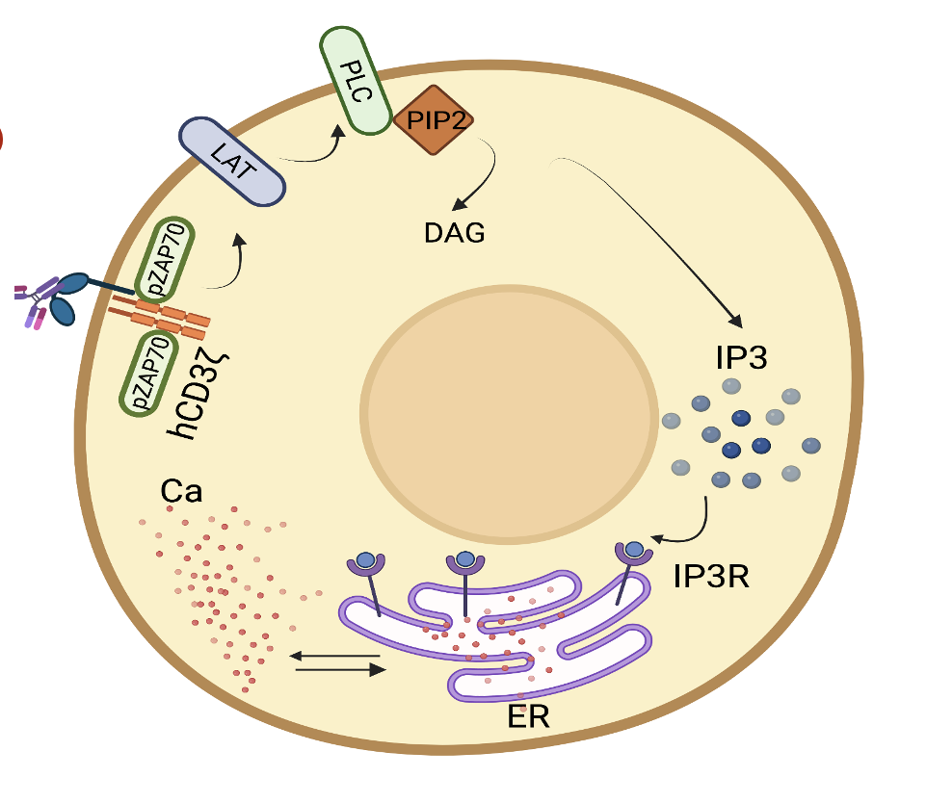
Modeling Ca++ flux to estimate parameters
Rule based model set up in Vcell
pZAP70

Slide 6
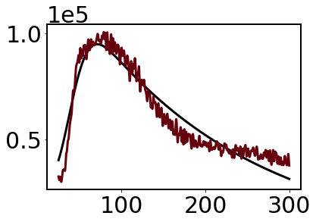
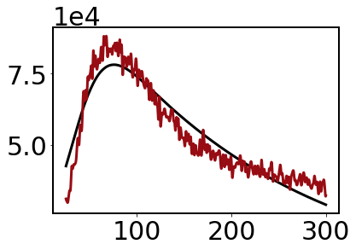
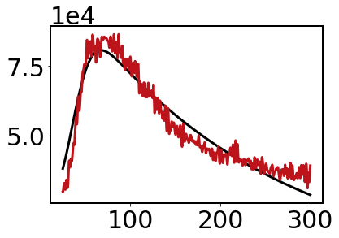
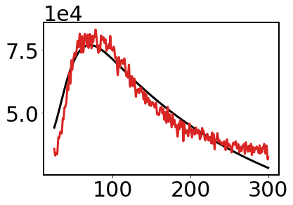
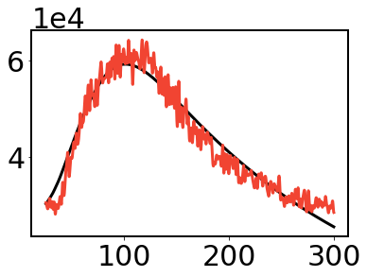
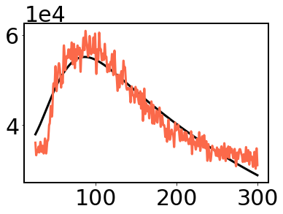
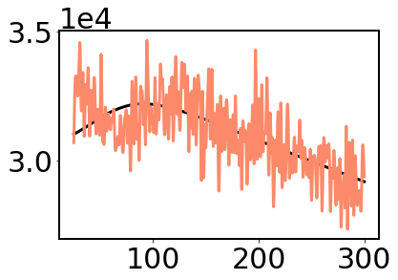
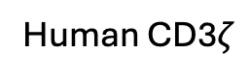
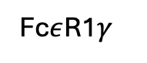
Estimating binding parameters (Kon, Koff, C1, C2, g)
46L+50F
46L+50F+53V
Human CD3$ζ$
Ca++
46L+53V
Fc$ε$R1$γ$
46L
WT
Time (s)

Slide 7
II. Surrogate model for Ca++ trajectories
Bionetgen runs for rule-based models may takes longer time
Finding moments (e.g., mean) could be time consuming
Parameter estimation in moments could take long time
Can surrogate model can help?
<Ca++>
Time (s)

Slide 8
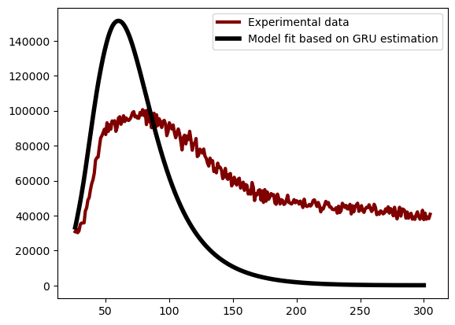
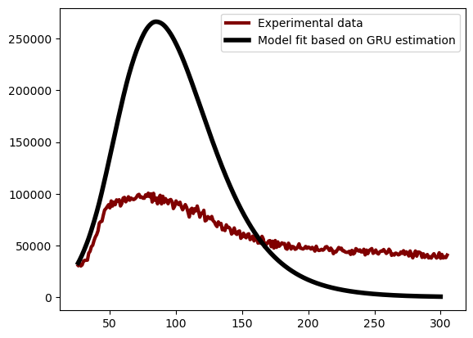
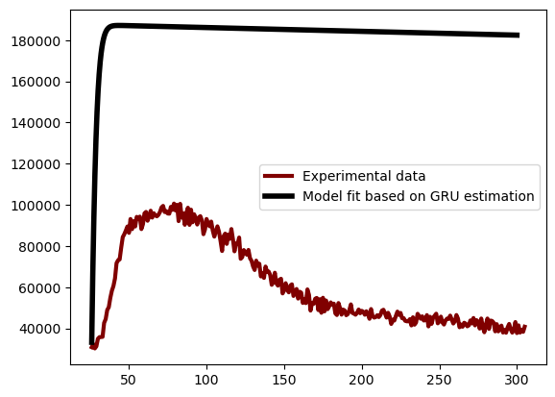
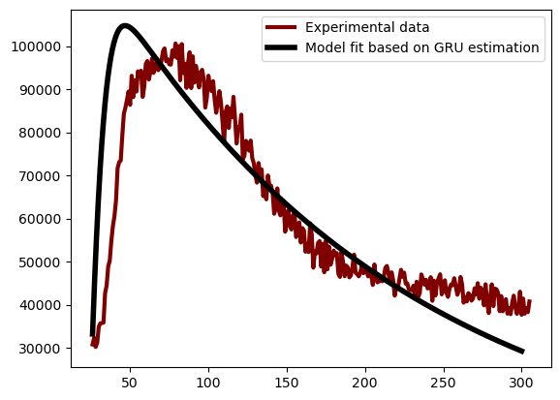
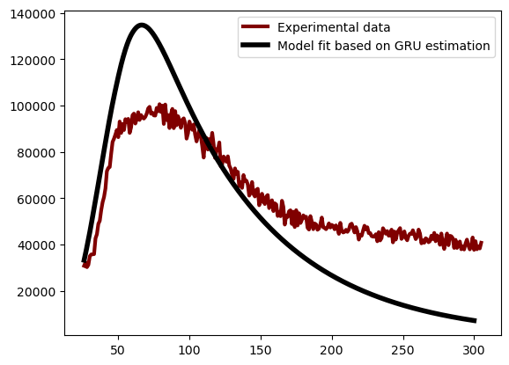
GRU prediction for single feature Ca
April 15, 2025
Maitreya
try1
try2
[[1.00061715e-04 1.00012748e-03 6.16701192e+05 3.63310336e+00
1.31592696e-02]]
Train Loss: 0.0242, Validation Loss: 0.0219

Slide 9
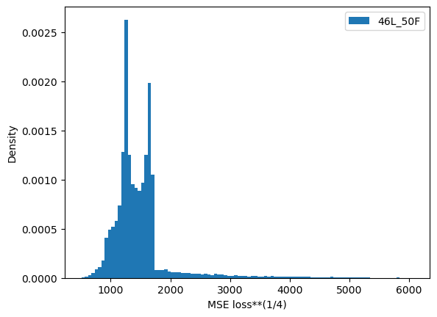
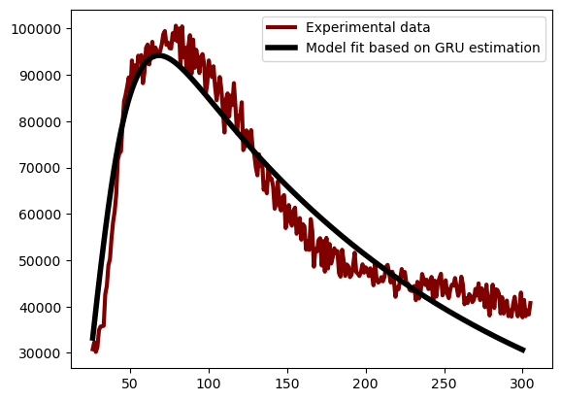
MSE between training data and 46L_50F
April 16, 2025
Yes, training data had trajectory it could fit
Ca
Time
kon=0.055000749940834
koff=0.0679472954711275
C1=99211.25556948685
C2=1.1964140281878095
g=0.0051028482720157

Slide 10
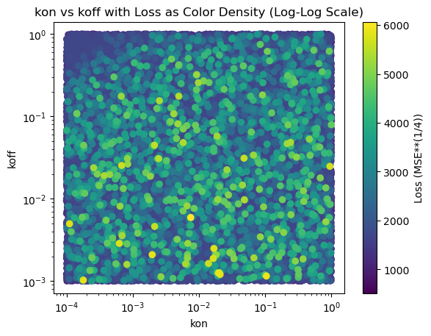
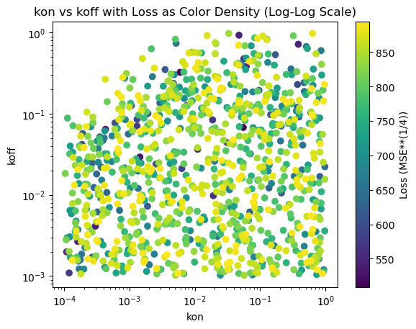
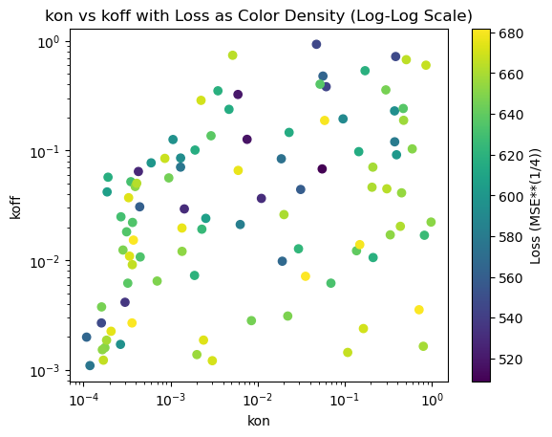
Loss landscape in training data (kon, koff, loss)
April 16, 2025
40000 data
1000 data
100 data

Slide 11
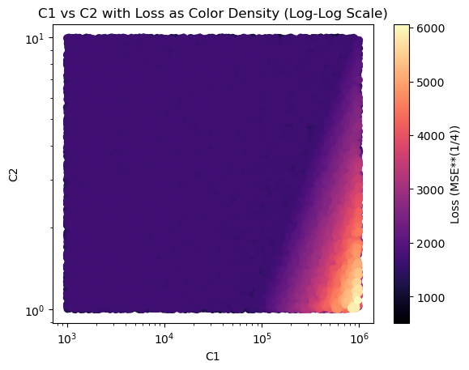
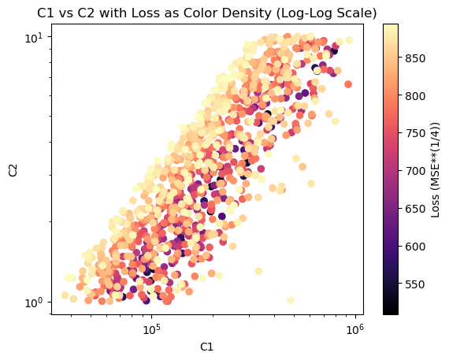
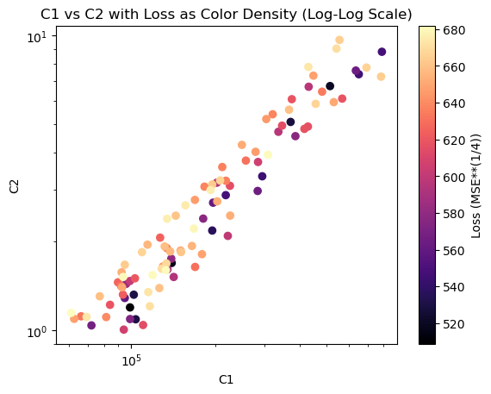
Loss landscape in training data (C1, C2,loss)
April 16, 2025
40000 data
1000 data
100 data

Slide 12
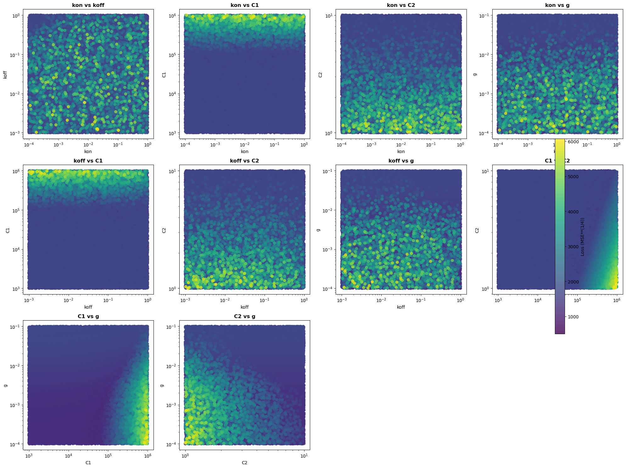
Loss landscape in training data
April 16, 2025

Slide 13
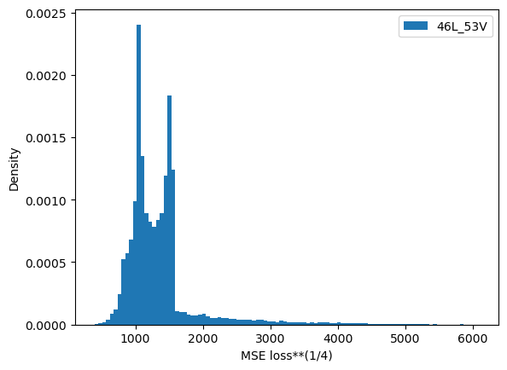
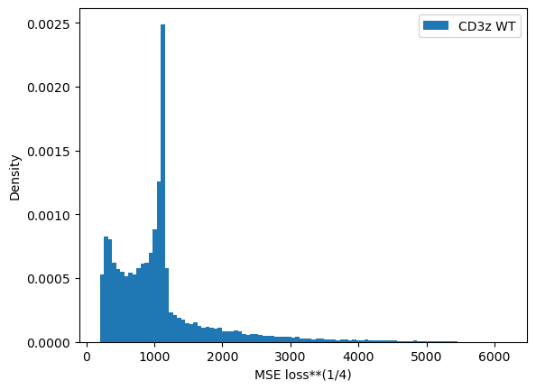
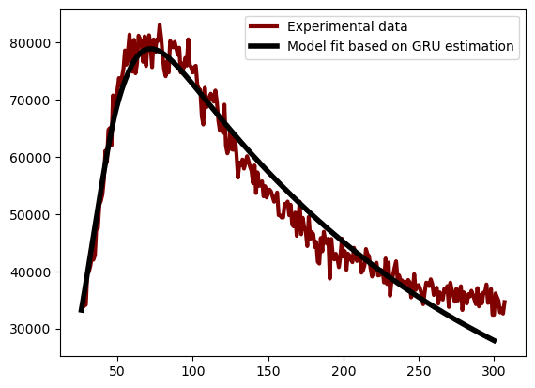
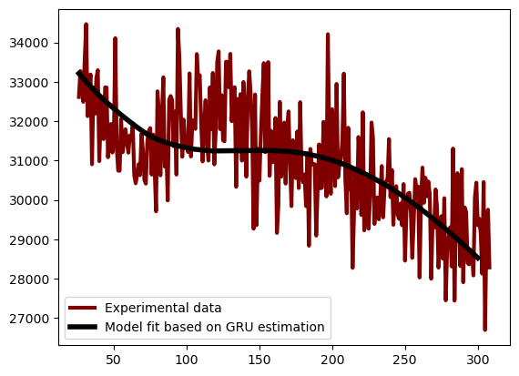
Fit with minimum MSE
April 16, 2025
46L+50F
46L+53V
WT
kon=0.0002556866840478
koff=0.06913953757773
C1=349395.40798055363
C2=5.449714015283929
g=0.0048108432350435
(SSR error)**0.25 = 388.00586091362686
kon=0.0002556866840478
koff=0.06913953757773
C1=349395.40798055363
C2=5.449714015283929
g=0.0048108432350435
(SSR error)**0.25 = 388.00586091362686
kon=0.0011878061859531
koff=0.7262623752973189
C1=25722.534526690044
C2=2.3872004256823565
g=0.0017165718604975
(SSR error)**0.25 = 212.75189931517218

Slide 14
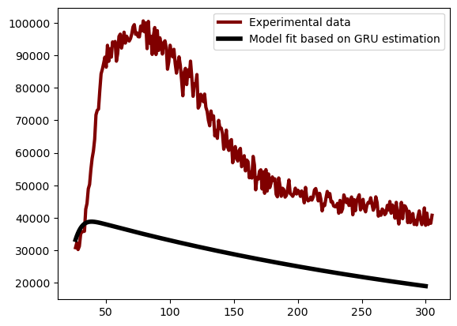
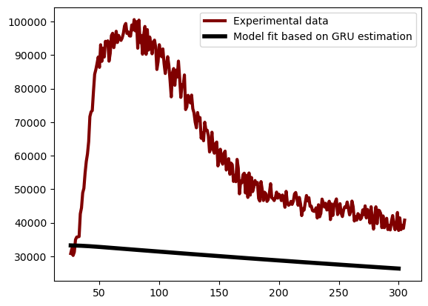
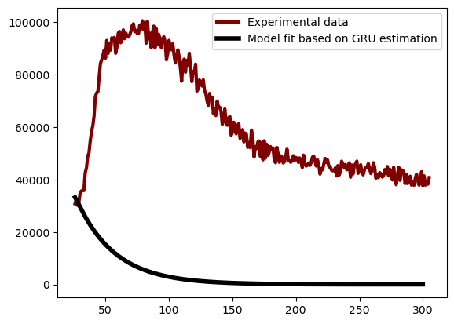
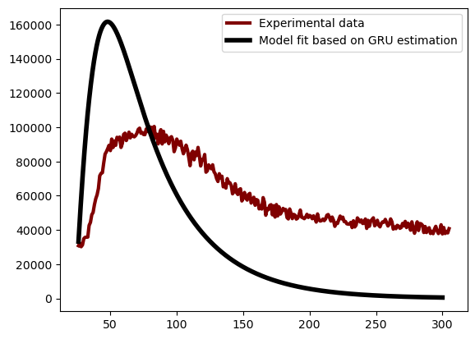
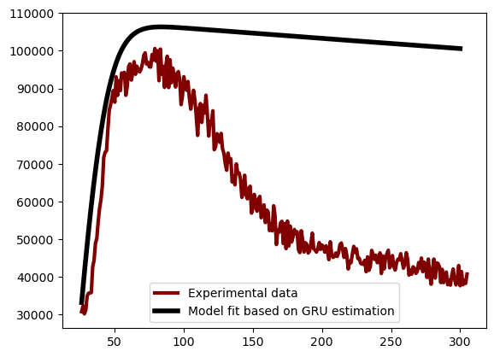
MSE between training data and 46L_50F
April 18, 2025

Slide 15
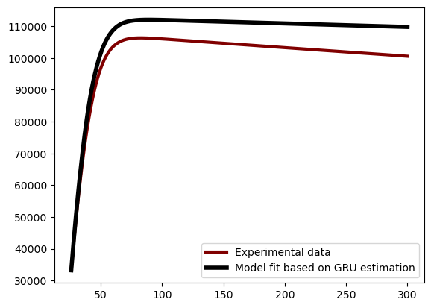
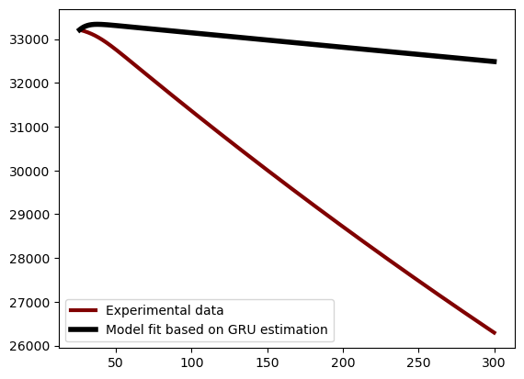

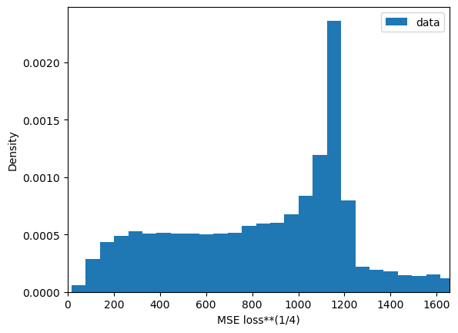
MSE between training data and 46L_50F
April 18, 2025
[1.83199672e-01 1.95395544e-01 2.73346353e+05 3.43676670e+00 1.00015227e-04]
Predict GRU estimates
[7.71255292e-02 6.78470036e-02 1.00008997e+03 5.64969114e+00 1.00015227e-04]
Predict GRU estimates

Slide 16
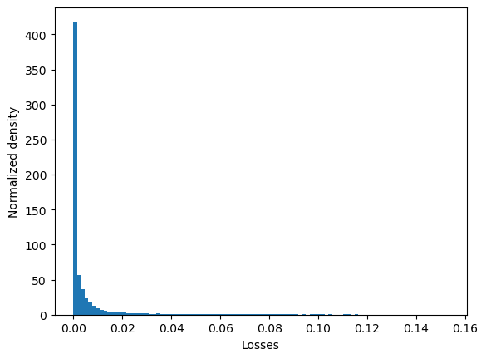
Three features included in training (mean Ca, h, pZAP)
Epoch [32/200], Train Loss: 0.0058, Validation Loss: 0.0052 -- Model saved
Training with 40000 files
Test files 11738

Slide 17
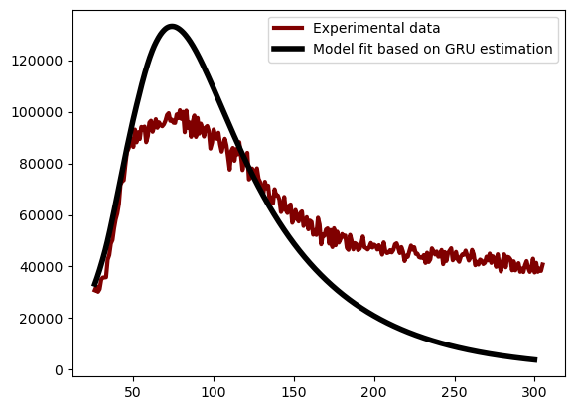
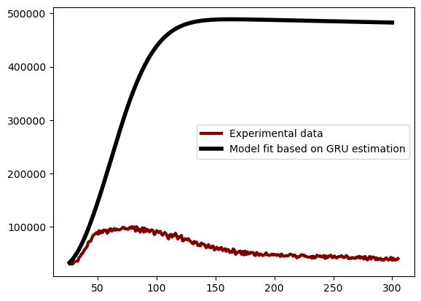
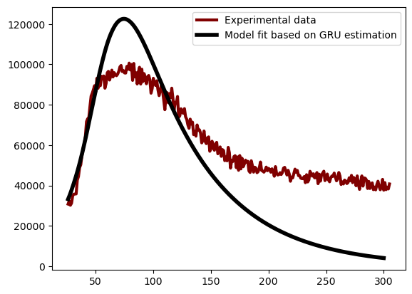
April 22, 2025
Try1
Try2
Try3
[1.00061715e-04 1.00012748e-03 4.20612416e+05
1.99623446e+00 1.70433662e-02]
[1.00061715e-04, 1.00012748e-03, 5.27647189e+05, 1.14439540e+00,1.00015227e-04]
[1.00061715e-04 1.00012748e-03 3.83530883e+05
2.10395883e+00 1.61573372e-02]
Epoch [41/200], Train Loss: 0.0279,
Validation Loss: 0.0263 -- Model saved
Epoch [71/200], Train Loss: 0.0397,
Validation Loss: 0.0375 -- Model saved
Epoch [191/200], Train Loss: 0.0245,
Validation Loss: 0.0238 -- Model saved

Slide 18
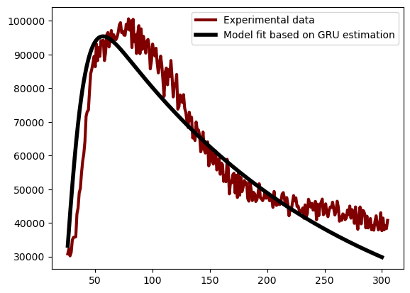
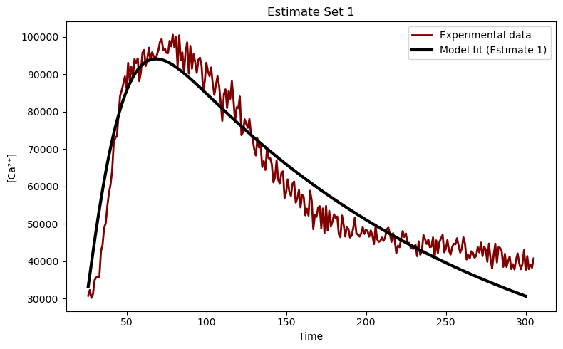
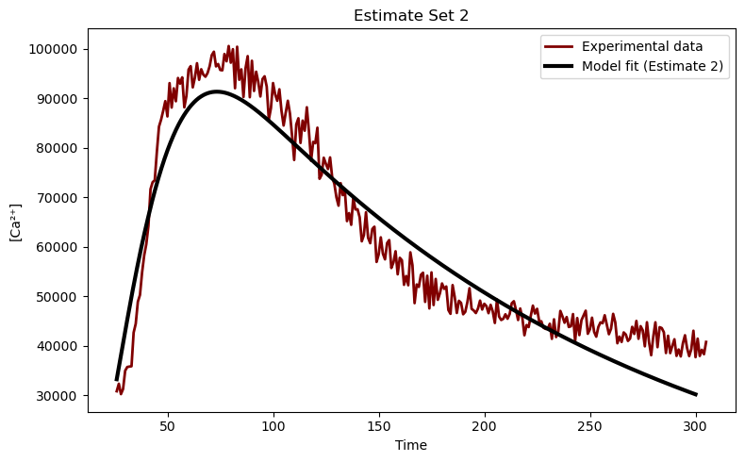
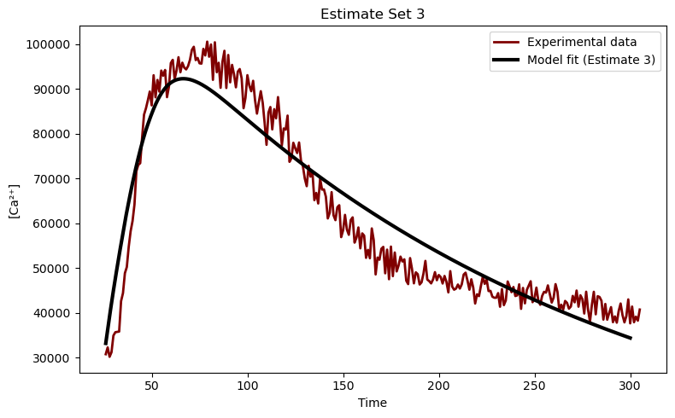

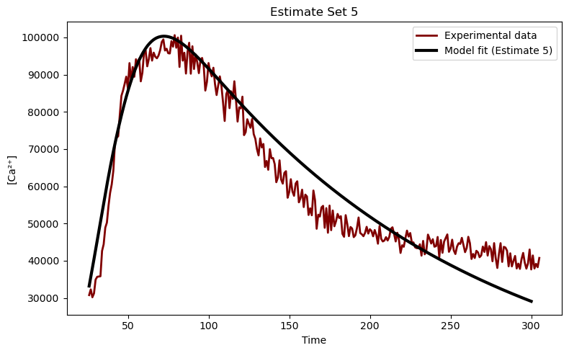
Fit with minimum 5 MSEs
April 22, 2025
46L+50F
Avg
Avg_estimates=[1.40693111e-02, 1.22541817e-01, 2.45838766e+05, 3.16412856e+00,4.94269282e-03, 5.20606097e+02]
estimate_sets = [[0.055000749940834, 0.0679472954711275, 99211.25556948685, 1.1964140281878095, 0.0051028482720157, 508.5422374792354],
[0.007550648347729798, 0.1264864343326455, 139779.58458072387, 1.6932404238008547, 0.0052055522153123, 517.0585120176187],
[0.0059312685574617, 0.3245796455171876, 514349.41762855026, 6.744162489789719, 0.004412609514731, 519.6179396802739],
[0.0004266162498309, 0.064360556902842, 371901.61190611974, 5.096381218835008, 0.0042255996105422, 527.7057535147328],
[0.0014372722181789, 0.0293351537867336, 103951.96014160308, 1.0904446173674869, 0.0057668544887191, 530.1060401615332],
[0.011020869768898, 0.0365928282572078, 102333.8792869549, 1.3214381668745236, 0.0045607476326856, 530.7068471598345],
[0.0002995588630305, 0.0041292650259886, 195141.0960632267, 2.181455240389088, 0.0050827541172782, 536.2510263854277],
[0.06111381323548631, 0.38210985095925, 294467.01905085327, 3.333081847482896, 0.0059209527090224, 544.3165998758168]]

Slide 19
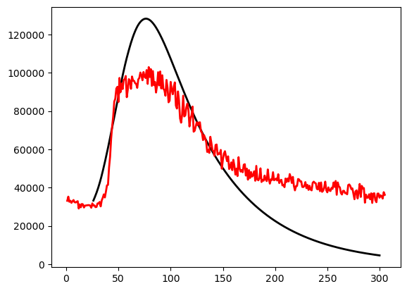

GRU estimates → PSO
April 23, 2025
GRU estimates: [1.00061715e-04, 1.00012748e-03, 4.20612416e+05, 1.99623446e+00, 1.70433662e-02]
10% of the GRU estimated values:
Lower bounds: [9.00555435e-05 9.00114732e-04 3.78551174e+05 1.79661101e+00 1.53390296e-02]
Upper bounds: [1.10067887e-04 1.10014023e-03 4.62673658e+05 2.19585791e+00 1.87477028e-02]
iter=20 (9 min)
iter=60 (26 min)
[9.49287971e-05 1.00414632e-03 4.20612760e+05 2.17532811e+00
1.59779089e-02]
898943347467.5729
residue ** (1/4) = 973.7177361596283
The time taken for the process is 9.071394014358521 min
[9.28191150e-05 1.06552503e-03 4.20612677e+05 2.15738803e+00
1.57979532e-02]
868412167696.0894
residue ** (1/4) = 965.342607124885
The time taken for the process is 27.019087366263072 min

Slide 20
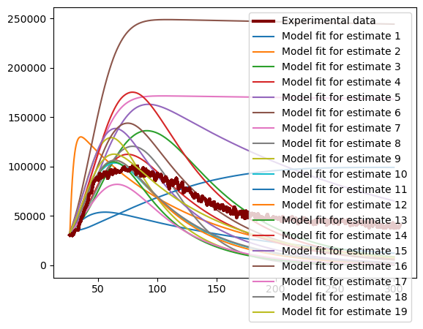
20 GRU estimates and fits on 46L_50F
April 23, 2025
[[9.28572168e-02 1.21255454e-01 7.49387067e+04 2.27269777e+00
6.29958672e-03]]
[[9.72394449e-02 1.00012748e-03 6.17459465e+05 5.62028135e+00
1.03108094e-02]]
[[1.00061715e-04 1.00012748e-03 2.64558159e+05 1.12669931e+00
1.49984374e-02]]
[[1.00061715e-04 1.00012748e-03 3.20217149e+05 2.04036946e+00
1.42842930e-02]]
[[1.00061715e-04 1.00012748e-03 3.47677822e+05 2.00706915e+00
4.68073080e-03]]
[[1.00061715e-04 1.00012748e-03 6.64696032e+05 3.06060388e+00
1.00015227e-04]]
[[1.00061715e-04 1.00012748e-03 4.75368218e+05 3.41017585e+00
1.00015227e-04]]
[[1.00061715e-04 1.00012748e-03 4.10412134e+05 1.14063254e+00
3.71899549e-02]]
[[1.00061715e-04 1.00012748e-03 6.91106697e+05 3.33589690e+00
2.39546687e-02]]
[[1.00061715e-04 1.00012748e-03 4.67508694e+05 3.31075334e+00
1.72674849e-02]]
[[1.00061715e-04 1.57814223e-01 2.50974106e+05 3.67451014e+00
1.00015227e-04]]
[[1.00061715e-04 1.00012748e-03 5.02762715e+05 3.34513074e+00
1.86000482e-02]]
[[1.00061715e-04 1.00012748e-03 5.82624025e+05 3.47816516e+00
2.34065899e-02]]
[[1.00061715e-04 1.00012748e-03 5.28360451e+05 1.88677917e+00
1.57966305e-02]]
[[1.00061715e-04 1.00012748e-03 6.52083070e+05 3.31271185e+00
1.75296347e-02]]
[[1.00061715e-04 1.00012748e-03 4.89917557e+05 2.30154122e+00
1.53466009e-02]]
[[1.00061715e-04 1.00012748e-03 3.12677373e+05 2.53181085e+00
2.05700475e-02]]
[[1.00061715e-04 1.00012748e-03 4.70566466e+05 3.30417135e+00
1.70504714e-02]]
[[1.00061715e-04 1.00012748e-03 5.76233596e+05 4.52653615e+00
1.18003175e-02]]

